Slide 1

Database Management Systems Cornerstone Project
Final Review (Review I & II)
LIBRARY MANAGEMENT SYSTEM
Presented by
T.RISHIKA(25B11AID25)
V.DEEPIKA (25B11AIC44)
U.DHARANI(25B11AIC23)
M.CHANDRA SEKHAR REDDY(25B11AID28)
Department of Artificial Intelligence & Machine Learning
Guided by
G.L.NARASAMBA.V
Assistant Professor

Slide 2

PRESENTATION OUTLINE
1.Abstract
2.Finalize title, objectives & problem statement
3.Identify entities & attributes
2.Design ER diagram & relationships
5.Prepare relational database schema
6.Define Primary & Foreign Keys
7.Create GitHub repo & responsibilities
8.Database creation & constraints
9.Insert sample data
10.DDL, DML & DQL operations
11.CRUD operations & SQL queries
12.Data integrity & validation
13.Project documentation
14.Demonstrate & present database
15.Conclusion

Slide 3
ABSTRACT
A Library Management System is a database-based application developed to manage library resources efficiently.
The system stores and manages information about books, members, library seats, contact enquiries, and book borrowing records.
It provides facilities to add, search, update, borrow, and return books while maintaining accurate availability information.
The system uses SQLite as the database and demonstrates important DBMS concepts such as DDL, DML, DQL, CRUD operations, constraints, aggregate functions, joins, views, and data validation.
The system reduces manual work, improves data organization, and provides quick access to library information.

Slide 4
INTRADUCTION
A Library Management System is a database-driven system designed to manage library operations.
It stores details of books in an organized database.
It maintains member information.
It manages book borrowing and returning records.
It tracks book availability.
It manages library seat availability.
It stores user contact messages and enquiries.
It provides search and filtering facilities.
It reduces manual paperwork.
It improves accuracy and data accessibility.
It demonstrates practical implementation of DBMS concepts.

Slide 5
PROBLEM STATEMENTS
Problem Statement
Managing books, members, authors, publishers, librarians, and issue/return transactions manually is time-consuming and may lead to duplication and errors. Searching for records and tracking book availability, due dates, and transactions also becomes difficult as the number of records increases.
Objectives
Maintain organized book records.
Manage member registration and details.
Track book availability.
Manage issue and return transactions.
Maintain author and publisher information.
Track issue, due, and return dates.
Reduce manual work and data errors.
Provide quick retrieval of library information

Slide 6
OBJECTIVES
Objectives of the Project
To manage library books efficiently.
To store and maintain book details.
To manage library member details.
To maintain book borrowing and returning records.
To track book availability.
To manage library seat availability.
To store contact and enquiry information.
To perform CRUD operations.
To implement DDL, DML and DQL operations.
To implement SQL joins and aggregate functions.
To create and use SQL views.
To maintain data integrity using constraints.
To provide quick and organized access to library information.

Slide 7
ENTITY AND ATTRIBUTES
ENTITY : BOOK
Attribute | Data Type | Constraint / Note | Attribute Type | Description
book_id | INT | PK | Simple | Book identifier
title | VARCHAR(200) | NOT NULL | Simple | Book title
isbn | VARCHAR(20) | UNIQUE NOT NULL | Simple | ISBN number
total_copies | INT |  | Simple | Total copies held
available_copies | INT | Derived | Derived | total − loaned
genre | VARCHAR(50) |  | Simple | Fiction/Science etc.
publication_year | YEAR |  | Simple | Year published
authors | TEXT | Multi-valued | Multi-valued | Book_Author table
ENTITY: FINE
Attribute | Data Type | Constraint / Note | Attribute Type | Description
fine_id | INT | PK | Simple | Fine identifier
loan_id | INT | FK → Loan | Simple | Related loan
member_id | INT | FK → Member | Simple | Member fined
fine_amount | DECIMAL(8,2) |  | Simple | Amount charged
fine_date | DATE |  | Simple | Date levied
payment_status | VARCHAR(20) |  | Simple | Paid/Unpaid

Slide 8
ENTITY : AUTHOR
Attribute | Data Type | Constraint / Note | Attribute Type | Description
author_id | INT | PK | Simple | Author identifier
first_name | VARCHAR(50) |  | Composite part | First name
last_name | VARCHAR(50) |  | Composite part | Last name
nationality | VARCHAR(50) |  | Simple | Country of origin
ENTITY : MEMBER
Attribute | Data Type | Constraint / Note | Attribute Type | Description
member_id | INT | PK | Simple | Member identifier
first_name | VARCHAR(50) |  | Composite part | First name
last_name | VARCHAR(50) |  | Composite part | Last name
email | VARCHAR(100) | UNIQUE | Simple | Email address
membership_type | VARCHAR(30) |  | Simple | Student/Faculty/Public
membership_date | DATE |  | Simple | Join date
membership_expiry | DATE |  | Simple | Expiry date
phone_numbers | TEXT | Multi-valued | Multi-valued | Member_Phone table

Slide 9
ENTITY : PUBLISHER
Attribute | Data Type | Constraint / Note | Attribute Type | Description
publisher_id | INT | PK | Simple | Publisher identifier
publisher_name | VARCHAR(100) | NOT NULL | Simple | Publisher name
country | VARCHAR(50) |  | Simple | Country
website | VARCHAR(200) |  | Simple | URL
ENTITY : LOAN
Attribute | Data Type | Constraint / Note | Attribute Type | Description
loan_id | INT | PK | Simple | Loan identifier
book_id | INT | FK → Book | Simple | Borrowed book
member_id | INT | FK → Member | Simple | Borrowing member
loan_date | DATE | NOT NULL | Simple | Date borrowed
due_date | DATE |  | Simple | Return deadline
return_date | DATE |  | Simple | Actual return date
days_overdue | INT | Derived | Derived | return_date − due_date
status | VARCHAR(20) |  | Simple | Active/Returned

Slide 10
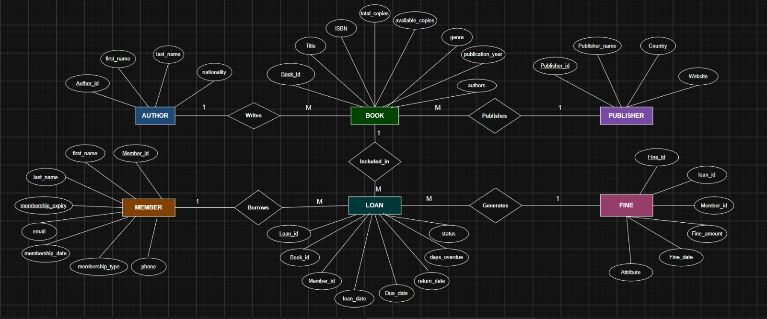
ER-DIAGRAM

Slide 11
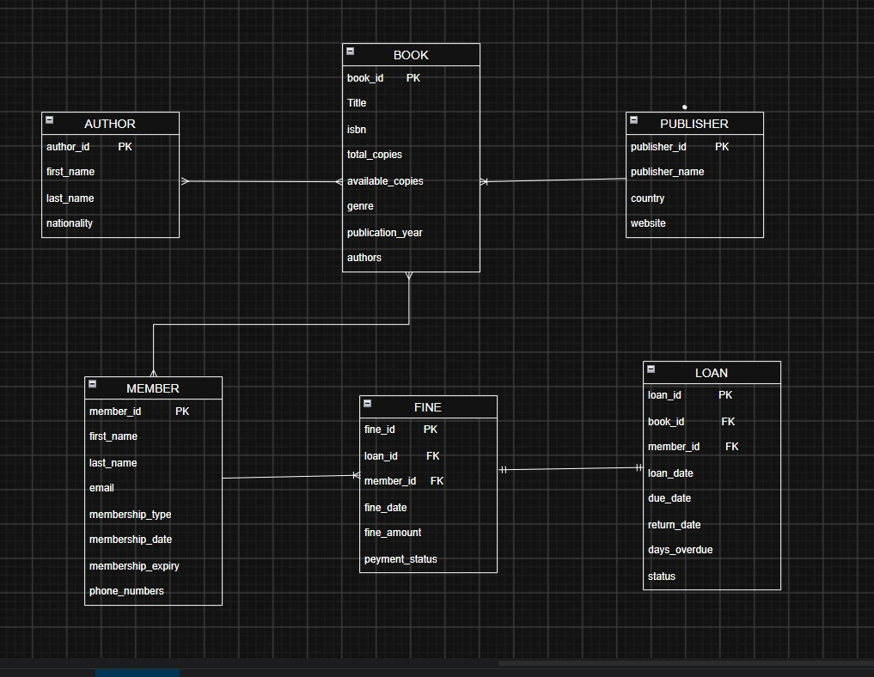
RELATIONAL DATABASE SCHEMA

Slide 12
PRIMARY AND FORIGEN KEYS
PRIMARY KEY
A Primary Key is an attribute that uniquely identifies each record (row) in a table.
Primary Keys:
Book → book_id
Author → author_id
Publisher → publisher_id
Member → member_id
Loan → loan_id
Fine → fine_id
Book_Author → book_id + author_id (Composite Primary Key)
FOREIGN KEY
Foreign Key is an attribute that links one table to another table by referring to the Primary Key of another
table.
Foreign Keys:
Book → publisher_id → Publisher(publisher_id)
Loan → book_id → Book(book_id)
Loan → member_id → Member(member_id)
Fine → loan_id → Loan(loan_id)
Fine → member_id → Member(member_id)
Book_Author → book_id → Book(book_id)
Book_Author → author_id → Author(author_id)

Slide 13
DATABASE CREATION & CONSTRAINTS
Database & Tables
Created the Library Management System database.
Created tables for Book, Author, Publisher, Member, Loan, Book_Author, and Fine.
Database:
CREATE DATABASE Library_Management_System;
Tables Created:
Book, Author, Publisher, Member, Loan, Book_Author, Fine
Constraints Used in Our Library Management System
PRIMARY KEY: Uniquely identifies each record.
Example: book_id, author_id, member_id
FOREIGN KEY: Connects related tables.
Example: publisher_id, book_id, member_id
NOT NULL: Ensures important fields cannot be empty.
Example: title, publisher_name, loan_date
UNIQUE: Prevents duplicate values.
Example: isbn, member email .
CHECK: Ensures valid values are entered.
Example: fine_amount >= 0 .
DEFAULT: Automatically provides a value when none is given.
Example: Loan status = 'Active‘.
Fine payment_status = 'Unpaid‘.

Slide 14
INSERT SAMPLE DATA
Table: Book
book_id | title | isbn | total_copies | genre | publisher_id
1 | Database System Concepts | 978-0073523323 | 5 | Technology | 1
2 | Clean Code | 978-0132350884 | 3 | Technology | 2
3 | The Alchemist | 978-0062315007 | 4 | Fiction | 3
Table: Loan
loan_id | book_id | member_id | loan_date | due_date | return_date | status
1 | 1 | 1 | 2024-07-01 | 2024-07-15 | 2024-07-13 | Returned
2 | 2 | 2 | 2024-07-10 | 2024-07-24 | NULL | Active
3 | 3 | 1 | 2024-07-20 | 2024-08-03 | 2024-08-10 | Returned

Slide 15
DDL, DML & DQL OPERATIONS
DDL – Data Definition Language
Used to create and modify database structures.
CREATE TABLE Publisher (
publisher_id INT GENERATED ALWAYS AS IDENTITY PRIMARY KEY,
publisher_name VARCHAR(100) NOT NULL,
country VARCHAR(50),
website VARCHAR(200)
);
CREATE TABLE Author (
author_id INT GENERATED ALWAYS AS IDENTITY PRIMARY KEY,
first_name VARCHAR(50),
last_name VARCHAR(50),
nationality VARCHAR(50)
);
CREATE TABLE Book (
book_id INT GENERATED ALWAYS AS IDENTITY PRIMARY KEY,
title VARCHAR(200) NOT NULL,
isbn VARCHAR(20) UNIQUE NOT NULL,
total_copies INT DEFAULT 1,
genre VARCHAR(50),
publication_year INT,
publisher_id INT,
FOREIGN KEY (publisher_id)
REFERENCES Publisher(publisher_id)
);

Slide 16
DDL, DML & DQL OPERATIONS
CREATE TABLE Member (
member_id INT GENERATED ALWAYS AS IDENTITY PRIMARY KEY,
first_name VARCHAR(50) NOT NULL,
last_name VARCHAR(50) NOT NULL,
email VARCHAR(100) UNIQUE,
membership_type VARCHAR(30),
membership_date DATE,
membership_expiry DATE
);
CREATE TABLE Loan (
loan_id INT GENERATED ALWAYS AS IDENTITY PRIMARY KEY,
book_id INT NOT NULL,
member_id INT NOT NULL,
loan_date DATE NOT NULL,
due_date DATE NOT NULL,
return_date DATE,
status VARCHAR(20) DEFAULT 'Active',
FOREIGN KEY (book_id)
REFERENCES Book(book_id),
FOREIGN KEY (member_id)
REFERENCES Member(member_id)
);
CREATE TABLE Fine (
fine_id INT GENERATED ALWAYS AS IDENTITY PRIMARY KEY,
loan_id INT UNIQUE NOT NULL,
member_id INT NOT NULL,
fine_amount DECIMAL(8,2) CHECK (fine_amount >= 0),
fine_date DATE,
payment_status VARCHAR(20) DEFAULT 'Unpaid',
FOREIGN KEY (loan_id)
REFERENCES Loan(loan_id),
FOREIGN KEY (member_id)
REFERENCES Member(member_id)
);

Slide 17
DDL, DML & DQL OPERATIONS
DML (Data Manipulation Language)
Used to insert, update, and delete data in the tables.
INSERT
INSERT INTO Member (member_id, first_name, last_name, email, membership_type) VALUES (1, 'Kavya', 'A', 'kavya@gmail.com', 'Student');
UPDATE
UPDATE Member SET membership_type = 'Faculty' WHERE member_id = 1;
DELETE
DELETE FROM Member WHERE member_id = 1;
DQL (Data Query Language)
Used to retrieve data from the database.
SELECT
SELECT * FROM Book;
SELECT with condition
SELECT title, genre FROM Book WHERE genre = 'Technology';

Slide 18
CRUD OPERATIONS & SQL QUERIES
CRUD Operations
CREATE – Insert new data
INSERT INTO Book (book_id, title, isbn, total_copies, genre) VALUES (4, 'Python Basics', '9781234567890', 3, 'Technology');
READ – View data
SELECT * FROM Book;
UPDATE – Modify data
UPDATE Book SET total_copies = 5 WHERE book_id = 4;
DELETE – Remove data
DELETE FROM Book WHERE book_id = 4;
View
CREATE VIEW Loan_Details AS SELECT l.loan_id, m.first_name, b.title, l.loan_date, l.due_date, l.status FROM Loan l JOIN Member m ON l.member_id = m.member_id JOIN Book b ON l.book_id = b.book_id;
Other SQL Query
SELECT title, total_copies FROM Book WHERE total_copies > 2 ORDER BY total_copies DESC;
SQL Queries
Join Query
SELECT Member.first_name, Book.title FROM Member JOIN Loan ON Member.member_id = Loan.member_id JOIN Book ON Loan.book_id = Book.book_id;
Aggregate Function
SELECT COUNT(*) AS total_books FROM Book;
CRUD operations, Joins, Aggregate Functions, Views, and filtering/sorting queries are
implemented to demonstrate
database functionality.

Slide 19
DATA INTEGRITY & VALIDATION
Data Integrity & Validation Rules
Rule | Implementation
No duplicate IDs | AUTO_INCREMENT PKs ensure uniqueness
No duplicate emails/codes | UNIQUE constraints on email, course_code, ISBN etc.
Valid range checks | CHECK constraints on marks, credits, quantity, rating
Referential integrity | FOREIGN KEY constraints with ON DELETE / UPDATE rules.
Non-null required fields | NOT NULL on all mandatory columns
No orphan records | FK relationships prevent insertion without parent record
No data redundancy | Normalization to 3NF; derived fields computed, not stored
Validation Through Constraints
PRIMARY KEY → Ensures each record has a unique ID.
FOREIGN KEY → Ensures valid relationships between tables.
NOT NULL → Prevents required fields from being empty.
UNIQUE → Prevents duplicate values such as isbn and email.
CHECK → Ensures valid values, e.g. fine_amount >= 0.
DEFAULT → Automatically assigns valid default values such as Active and Unpaid.

Slide 20
AGGREGATE FUNCTIONS & JOINS
Aggregate Functions
An aggregate function is a SQL function that performs a calculation on a group of rows and returns a single value as the result.
JOIN Query – Member, Loan & Book
Purpose:
Displays which member borrowed which book, along with the loan date, due date, and loan status.
-- COUNT
SELECT COUNT(*) AS total_books
FROM Book;
-- SUM
SELECT SUM(total_copies) AS total_book_copies
FROM Book;
-- AVG
SELECT AVG(total_copies) AS average_copies
FROM Book;
-- SUM of Fines
SELECT SUM(fine_amount) AS total_fine
FROM Fine;
SELECT
Member.first_name,
Book.title,
Loan.loan_date,
Loan.due_date,
Loan.status
FROM Member
JOIN Loan
ON Member.member_id = Loan.member_id
JOIN Book
ON Loan.book_id = Book.book_id;

Slide 21
PROJECT DOCUMENTATION
The project documentation contains:
Abstract
Introduction
Problem Statement
Objectives
Entity and Attributes
ER Diagram
Relationships and Cardinality
Relational Schema
Primary and Foreign Keys
Database Tables
Constraints
Sample Data
DDL Operations
DML Operations
DQL Queries
CRUD Operations
Aggregate Functions
JOIN Queries
Views
Data Integrity and Validation
Screenshots
GitHub Repository
Team Responsibilities
Conclusion
References

Slide 22
Team Member | Responsibility
THUTA RISHIKA | ER Diagram and Database Schema
VANTAPATI DEEPIKA | DDL – Table Creation and Constraint
UNGARALA DHARANI TEJASWINI | DML, CRUD Operations, Joins and Aggregate Functions
MEKALA CHANDRA SEKHAR REDDY | Documentation and Screenshots
GITHUB & TEAM RESPONSIBILITIES
GitHub Repository
Smart Library Management System
Repository:
https://github.com/rishika1527-stack/Library-management-system-dbms..git
Adjust these assignments if your actual team work is different.

Slide 23
CONCLUSION
Designed a Library Management System to manage books, authors, publishers, members, loans, and fines.
Implemented the database using 7 relational tables with primary keys and foreign keys.
Used constraints such as PRIMARY KEY, FOREIGN KEY, UNIQUE, NOT NULL, DEFAULT, and CHECK to maintain data integrity.
Implemented CRUD operations, JOINs, aggregate functions, views, filtering, and sorting queries.
Learned how to design an ER model, relational schema, normalized database, and SQL queries.
Future Enhancements: Add book reservations, automated fine calculation, due-date notifications, and a user-friendly application interface.
Applied DDL, DML, and DQL operations for database creation, data manipulation, and data retrieval.

Slide 24
THANK YOU

